Slide 1
Carpooling App

Slide 2
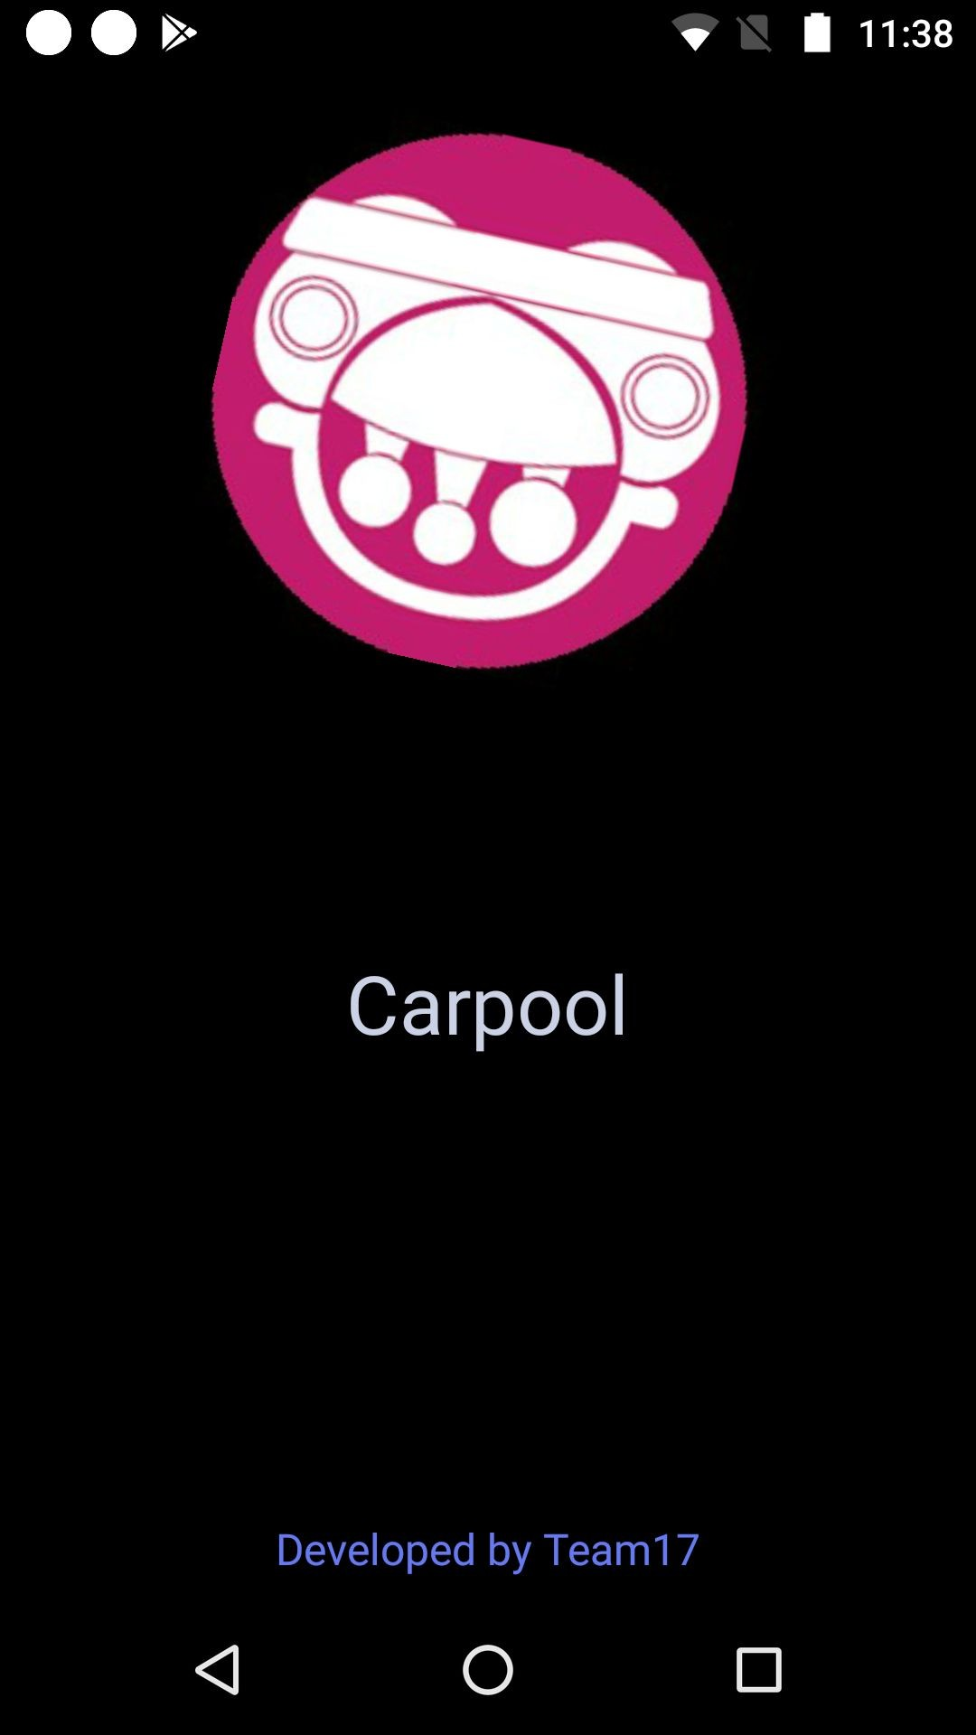
Splash Screen

Slide 3
Login Page
Users can login using their gmail account.

Slide 4
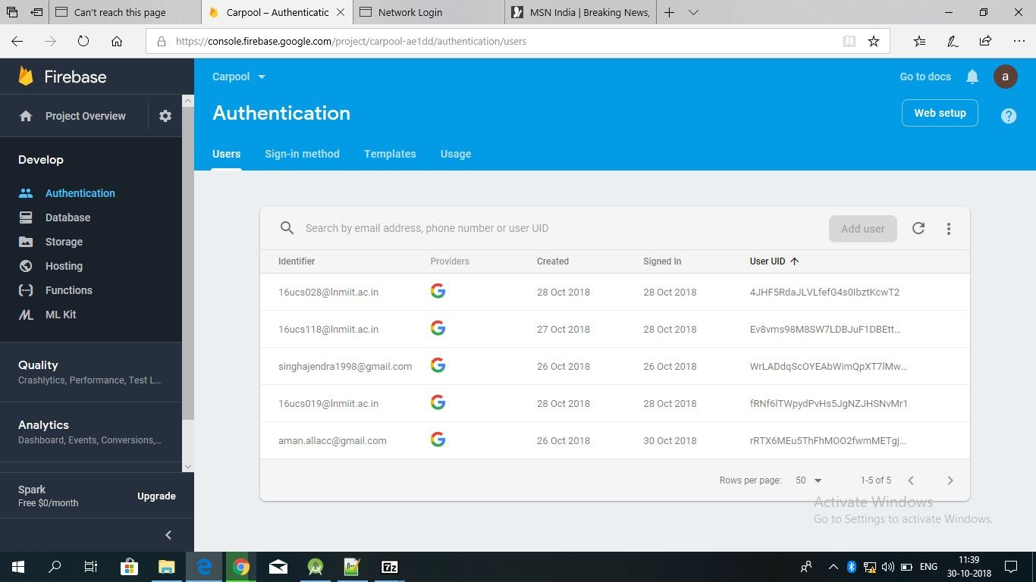
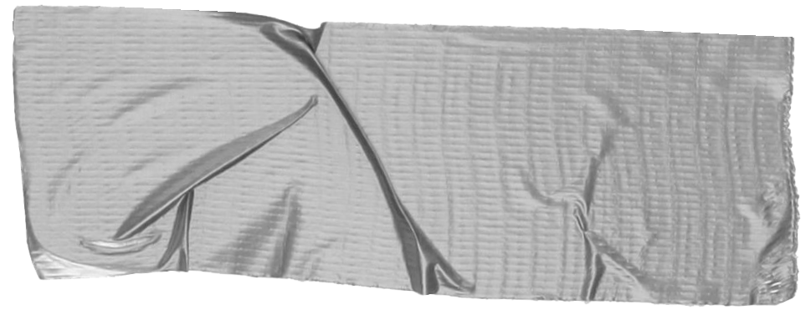

Just one! Your own.
(With a little help from your smart phone)
Tip
Remember. If something sounds like common sense, people will ignore it.
Highlight what is unexpected about your topic.

Slide 5
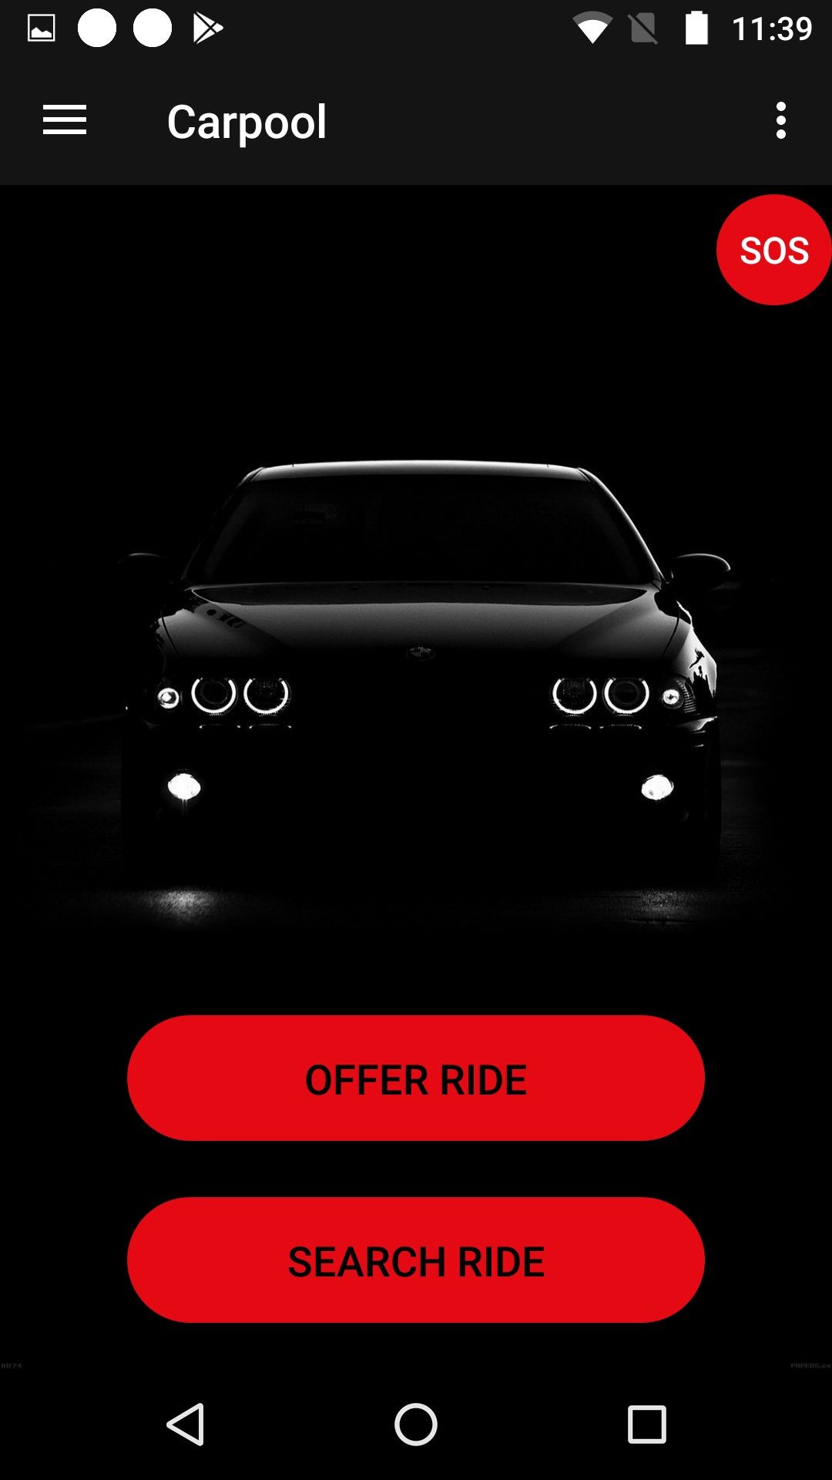
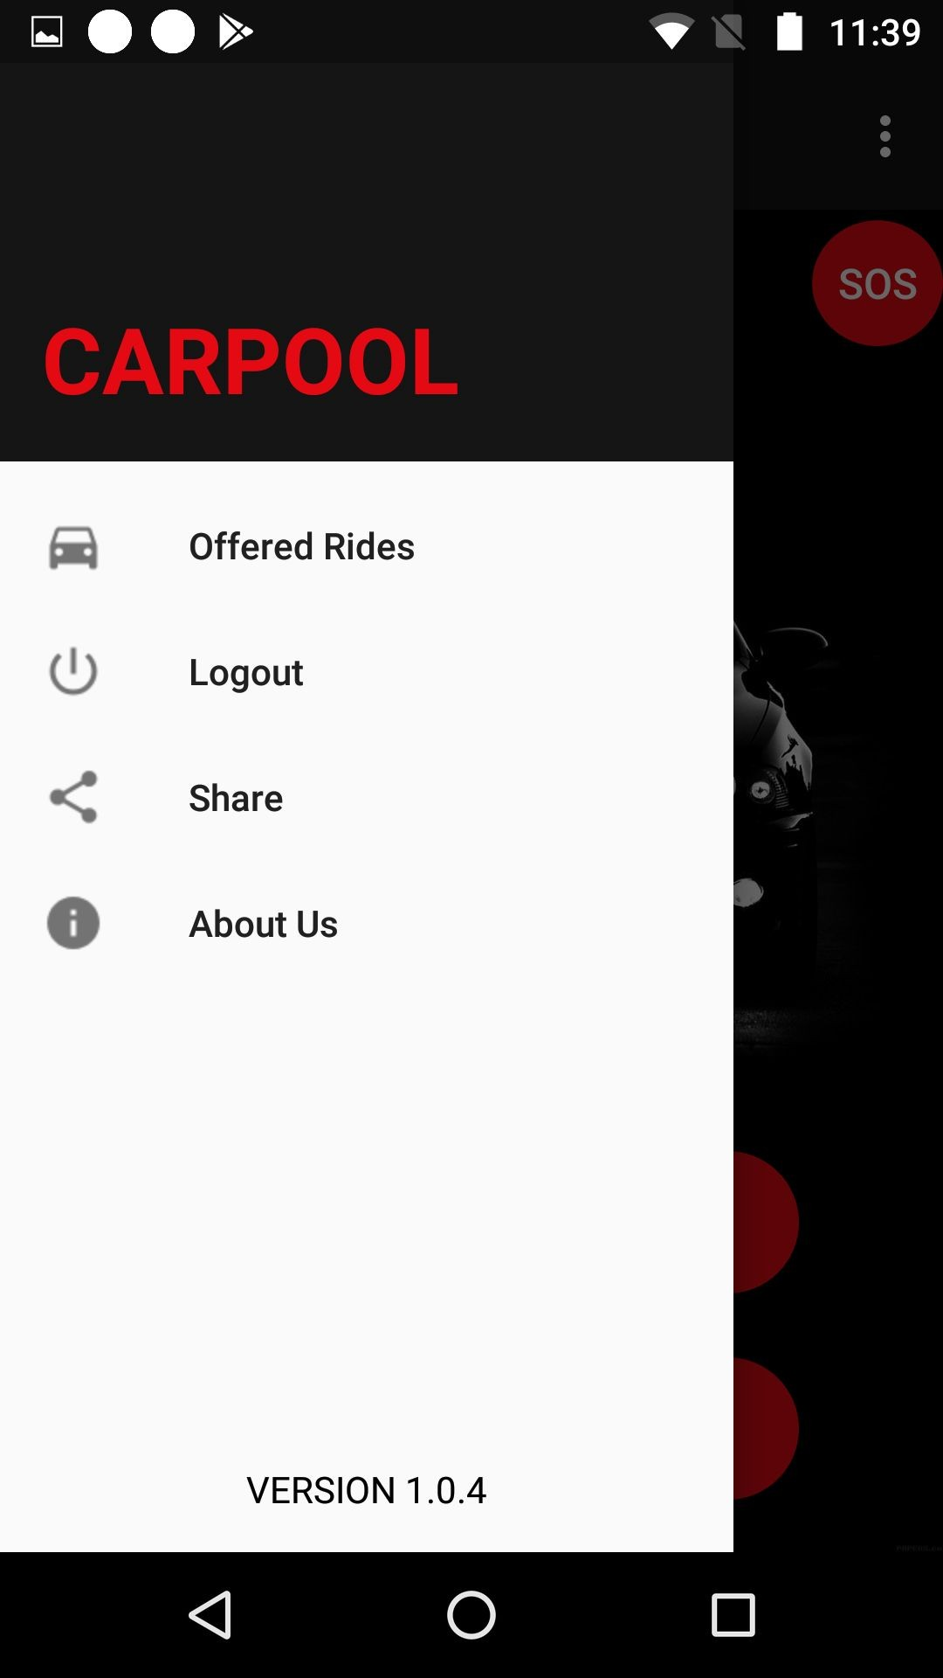
Home Page
After a user logs in using gmail account the home screen opens.Here they can offer or search a ride.
A navigation Drawer has also been given, so that user can view its offered rides, logout from the app etc.

Slide 6
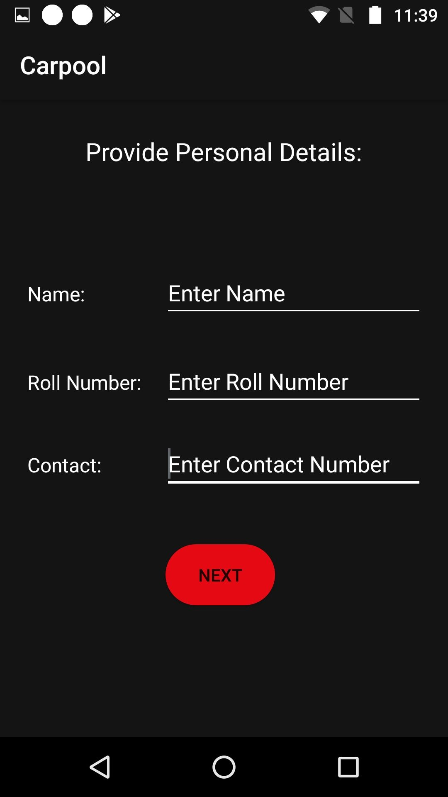
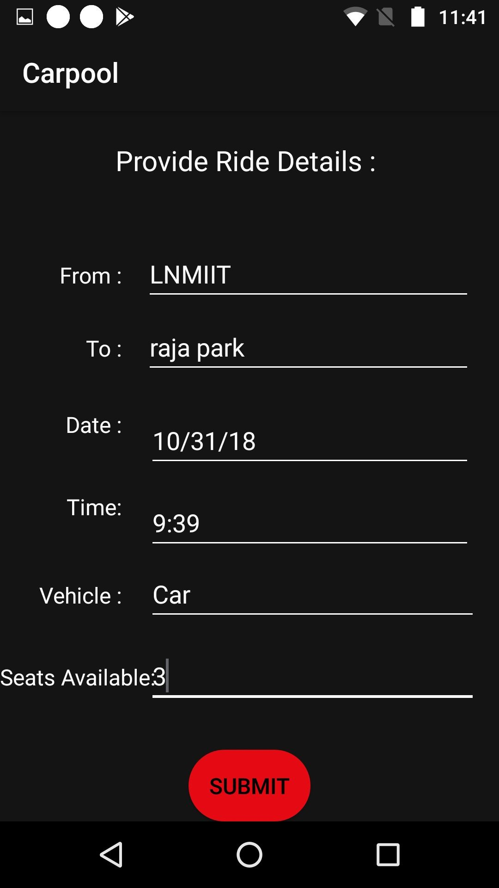
If you select offer ride option then you have to enter your details and the ride details.

Slide 7
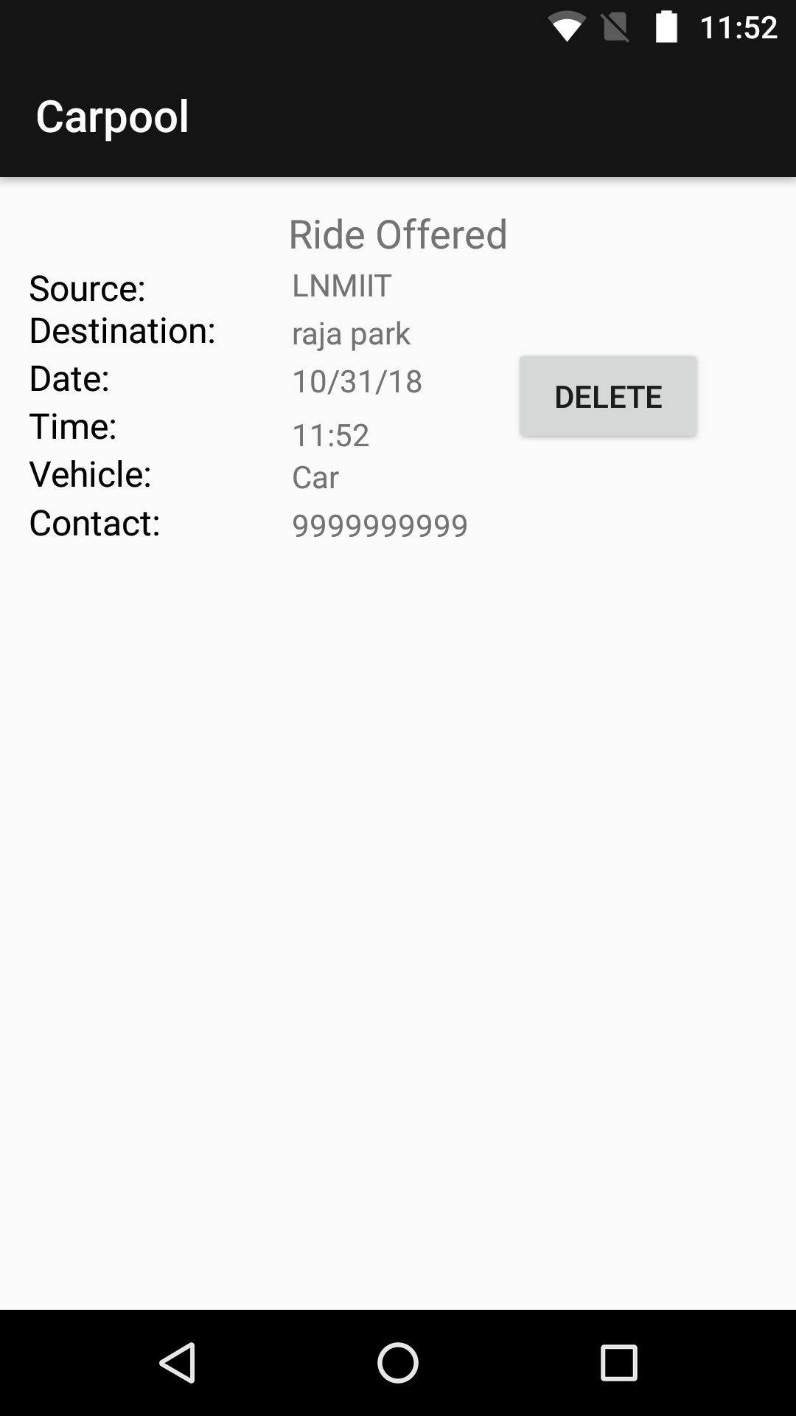
Once all the details have been entered the ride is posted, and this screen shows latest offered ride, which can also be deleted.

Slide 8
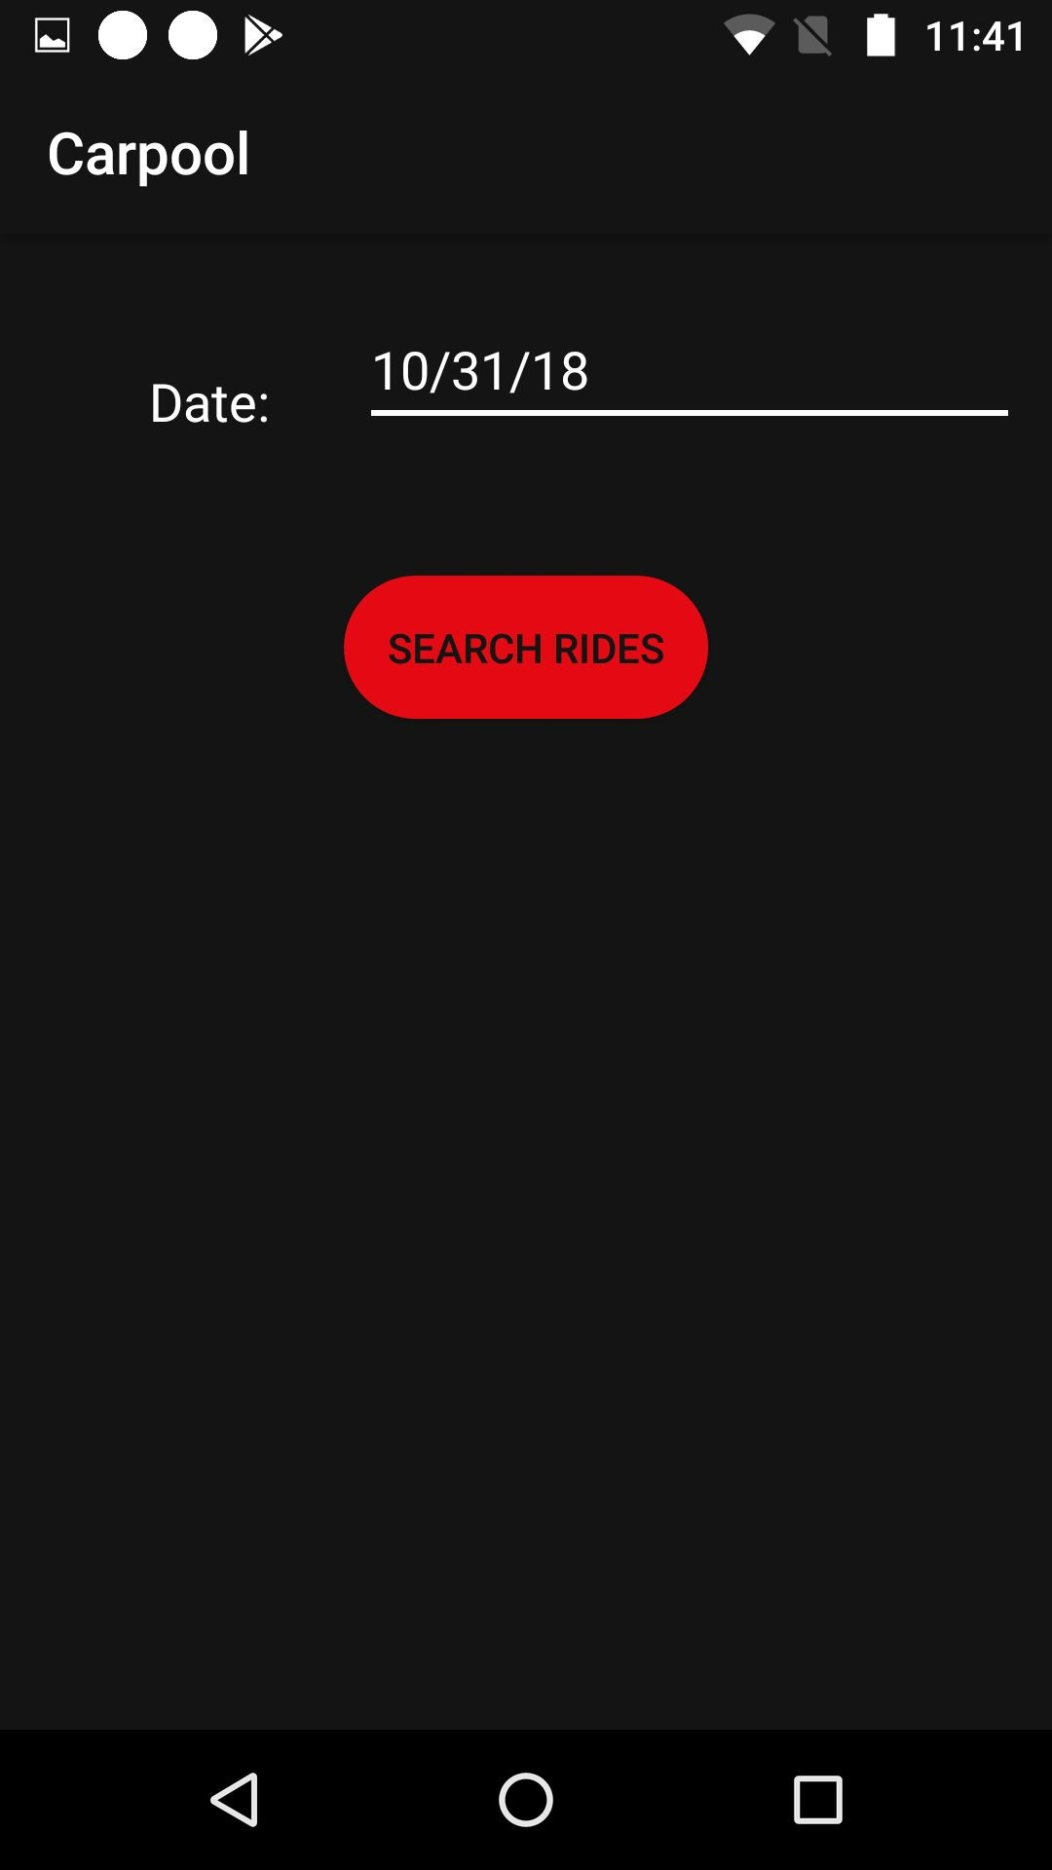
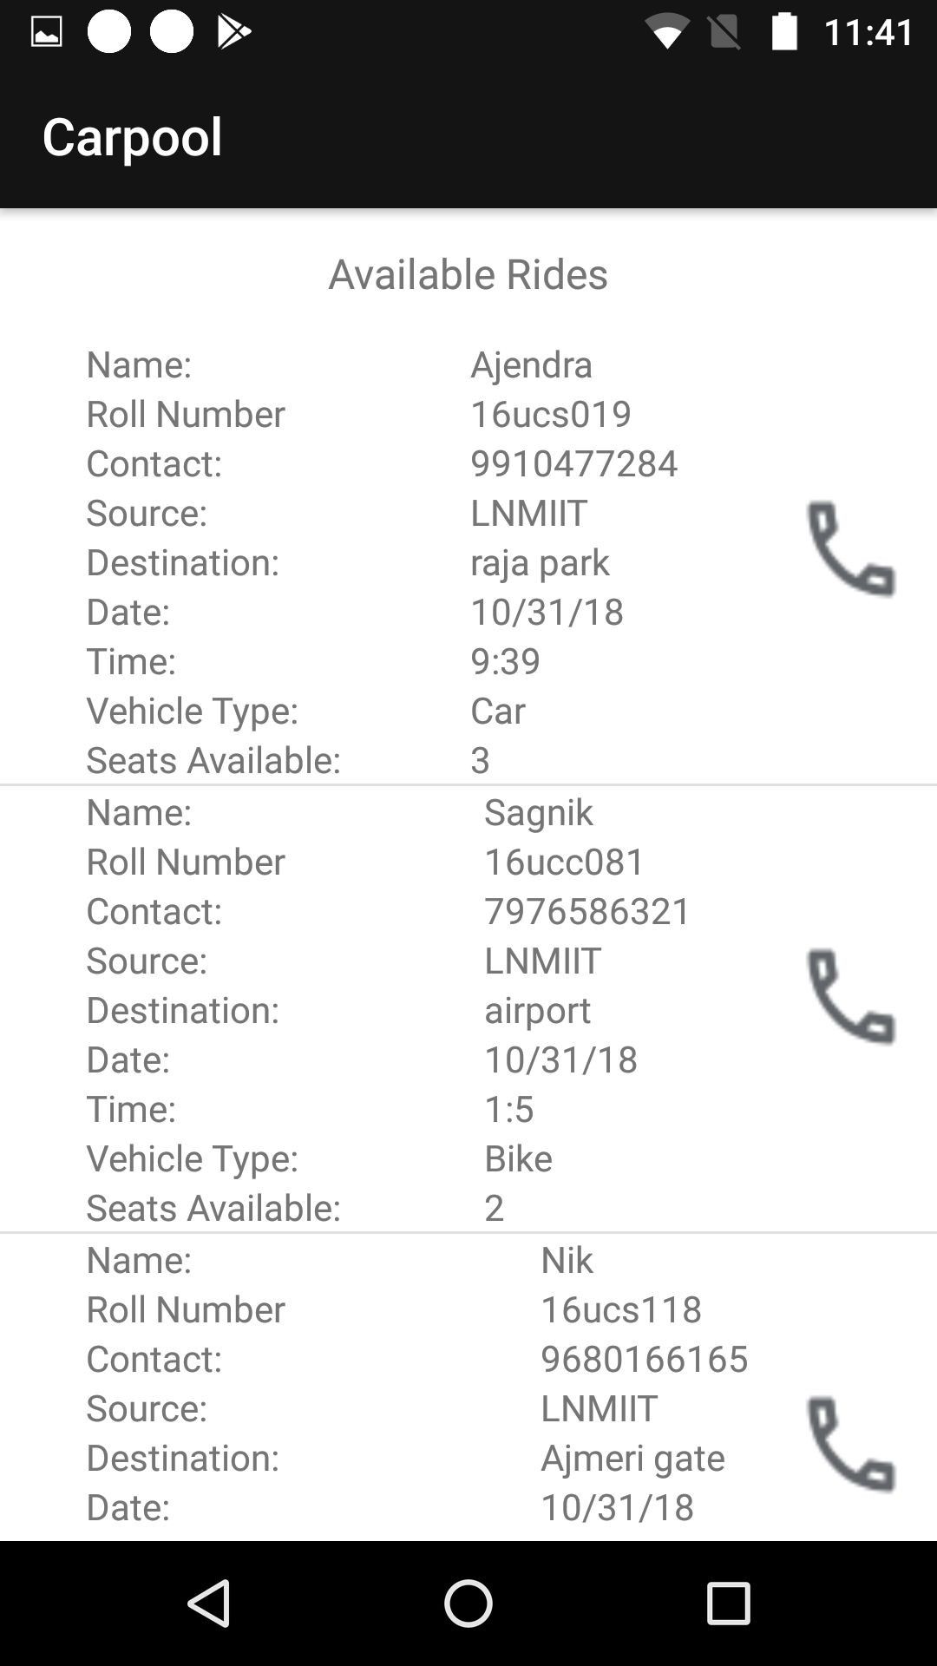
If you select search ride option then you need to specify the date you need to search for, and all the available rides of that datewill be shown.

Slide 9
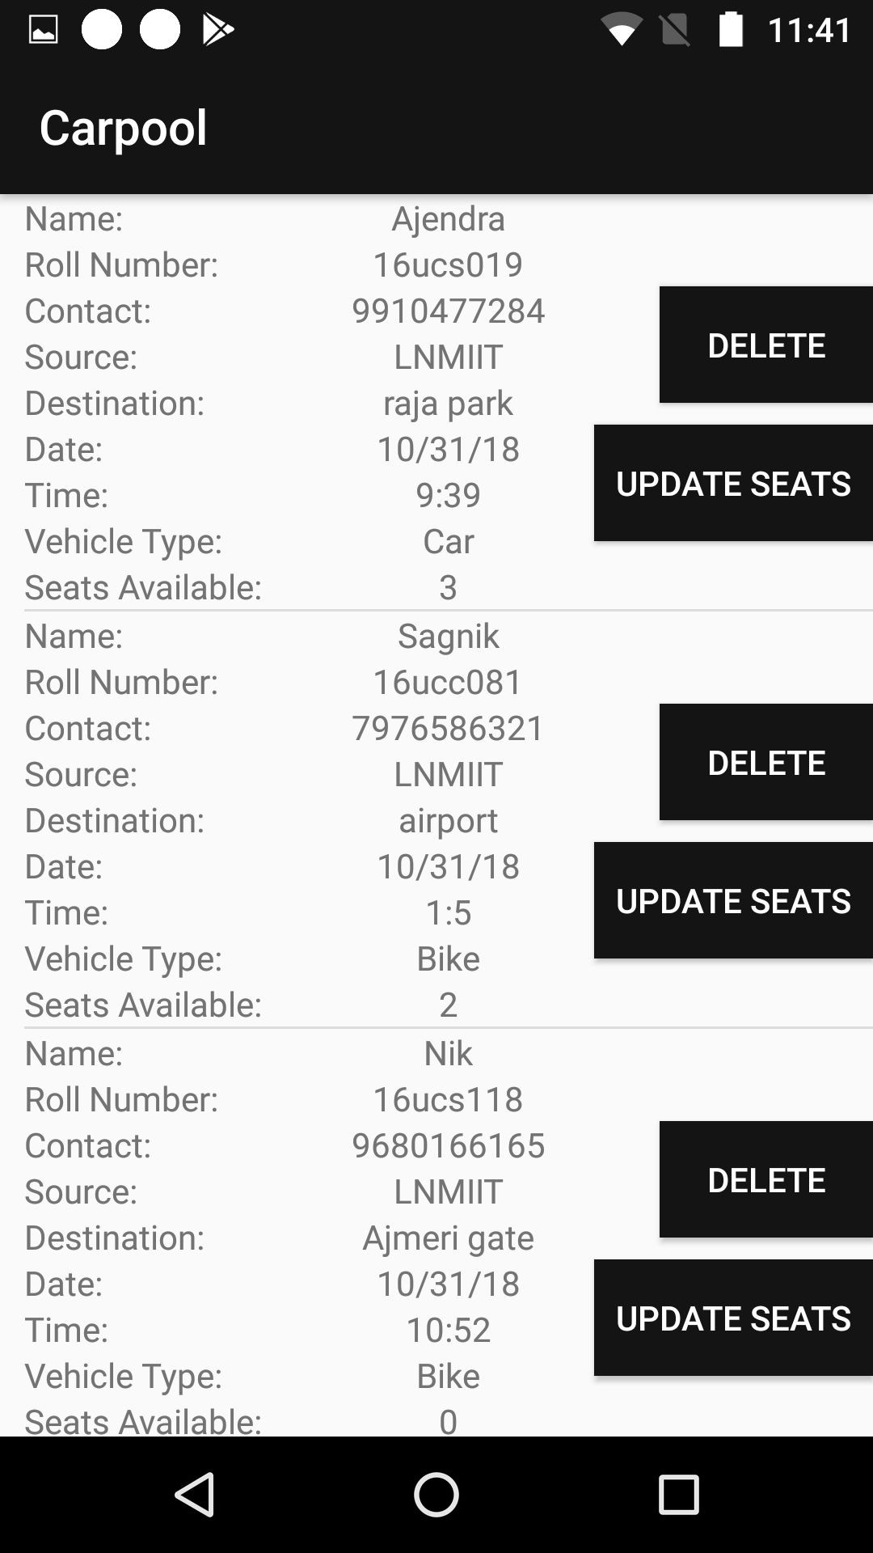
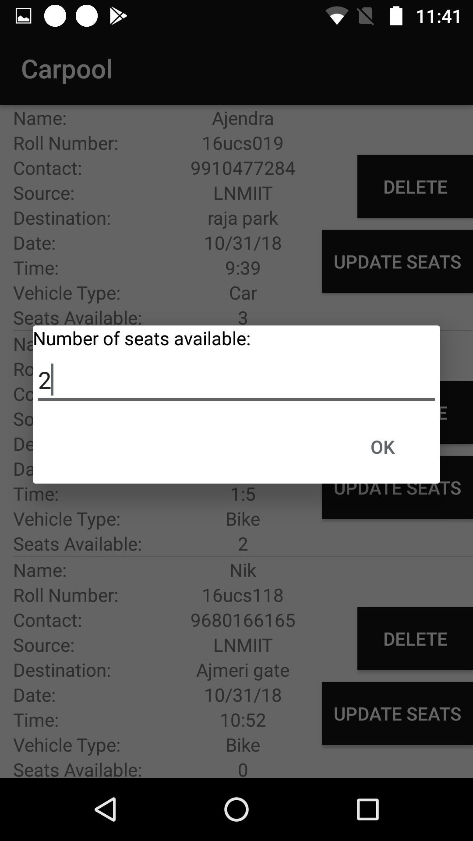
You can also update the number of seats available in the rides you have offered.

Slide 10
Database

Slide 11
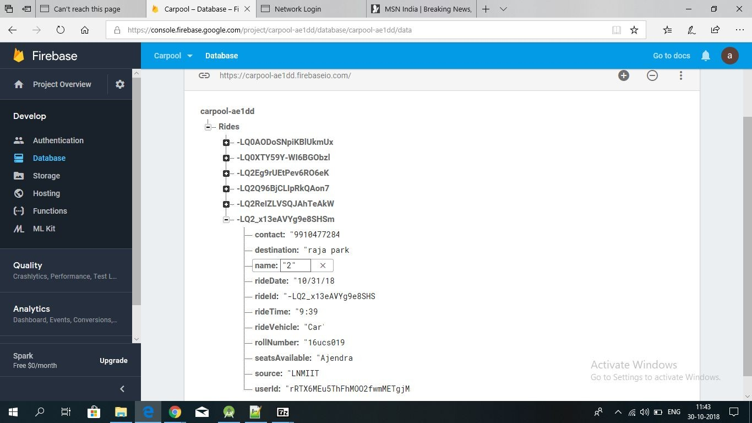

Slide 12
Data Flow Diagram:
User Authentication
Sign in with Google ID
User Device
Email and Password
Firebase
Assigns UID

Slide 13
Data Flow Diagram:
Notifying User
User Device
Adds Ride
Firebase
Sends Notification

Slide 14
Data Flow Diagram:
Functionality
Device Offering Ride
Send Ride Details
Firebase
Sends Stored Ride Details
Device Searching Ride

Slide 15
Data Flow Diagram:
Updating Seats
Device Offering Ride
Sends Updated Seats
Firebase
Receives Updated Ride Details
Device Searching Ride

Slide 16
Data Flow Diagram:
View Offered Rides
User
Offers Ride
Firebase
Sends Stored Offered Rides
Same User

Slide 17
THANK YOU

